Slide 1
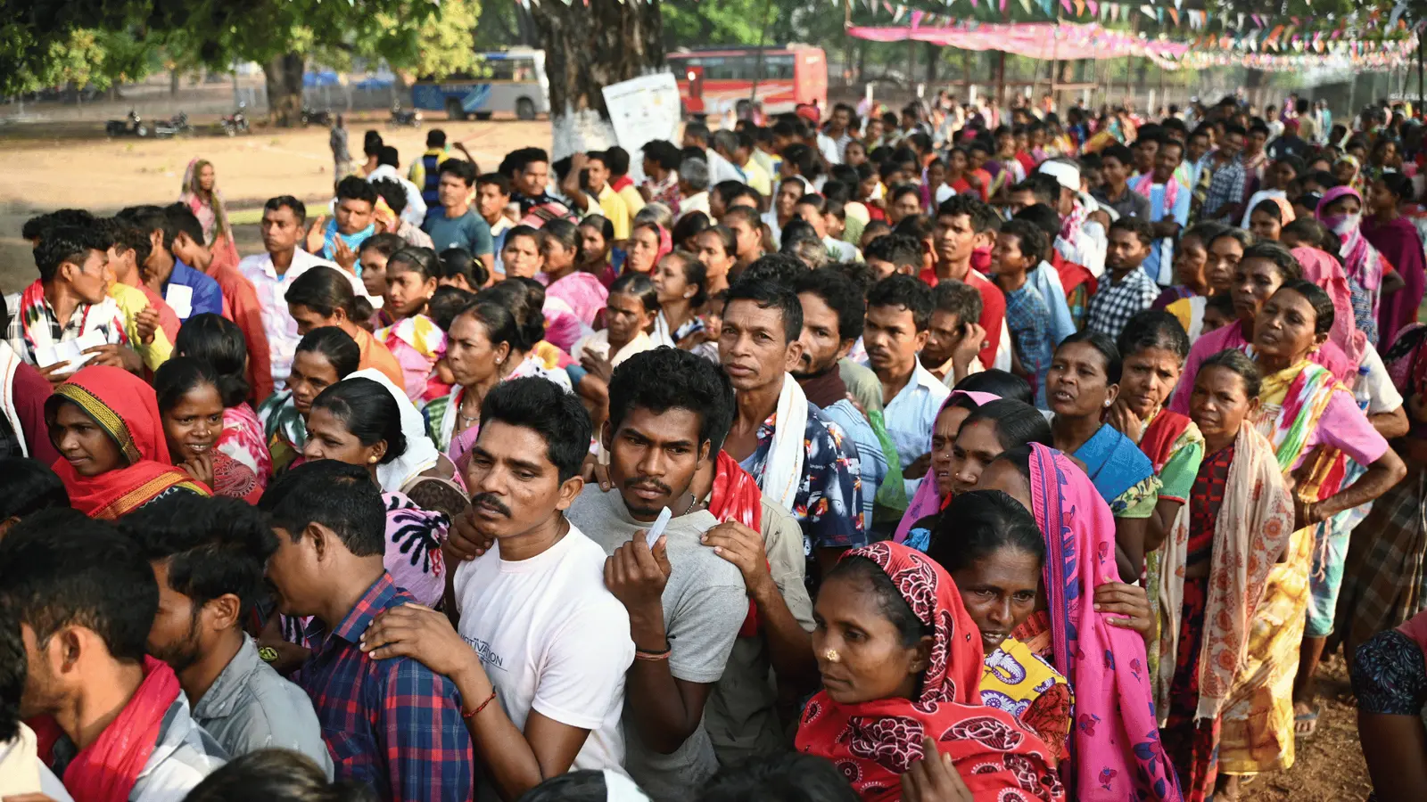
General Election of India
Comprehensive Data Analysis
2024
Presented by -
Sourajit Guha

Slide 2
1. Introduction
2. Objectives of the Project
3. Methodology
4. Key Statistics
5. Vote Analysis
6. Party-wise & Alliance Performance
7. Constituency Analysis
8. Winning Candidates & Runner-ups
9. Conclusion & Recommendations
10. Q&A
Project Agenda
Slide 1

Slide 3
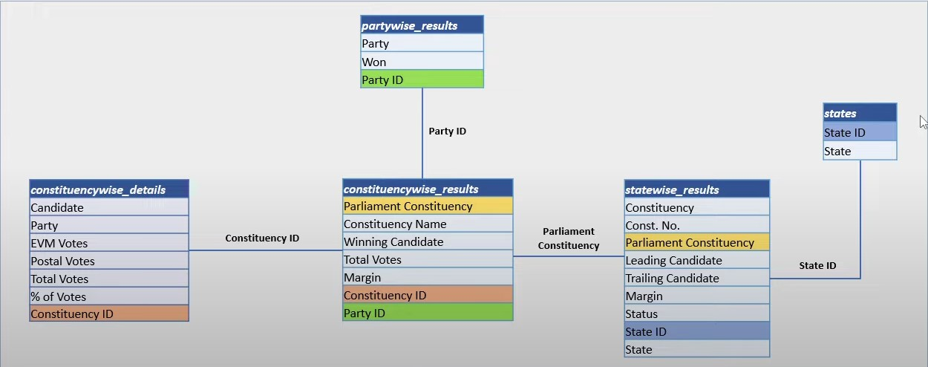
Table Schema Structure
Slide 2

Slide 4
Introduction
Overview of Indian General Elections
The General Elections of India are one of the largest democratic exercises in the world, conducted to elect members of the Lok Sabha, the lower house of India's bicameral Parliament. These elections are held every five years and involve the participation of hundreds of political parties and millions of voters across the country.
Importance of General Elections in a Democratic Setup
Foundation of Democracy, Expression of the People's Will, Ensures Accountability, Promotes Political Equality,
Peaceful Transfer of Power, Encourages Political Awareness, Reflects Federalism and Diversity,
Scope of the analysis
This analysis focuses on understanding the electoral landscape of the Indian General Elections through data-driven insights. It covers multiple dimensions, including voter behavior, party performance, and candidate competitiveness.
Slide 3

Slide 5
Objectives of the Project
Analyze Electoral Outcomes
Examine Voter Participation
Evaluate Party Performance
Assess Constituency-Level Patterns
Visualize and Communicate Insights
Promote Data-Driven Political Understanding
Slide 4

Slide 6
Methodology
Collecting Data
Cleaning And Preparation
Uploading to the Data base
Comparative Analysis
Slide 5
Results and Reports

Slide 7
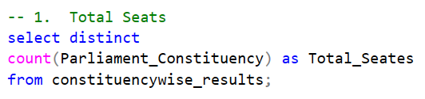
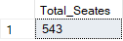
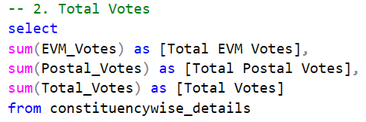
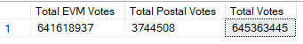
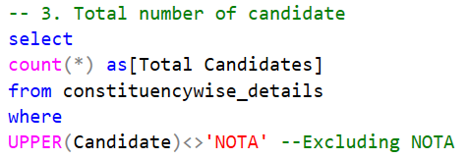
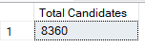
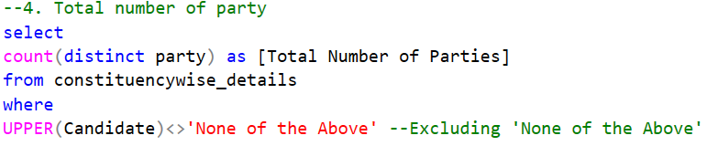
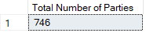
Key Statistics
Q1. What is the number of total seats in General Election 2024?
Result
Q2. What is the Total of number Votes in General Election 2024?
Result
Q3. What is the number of candidate in General Election 2024?
Result
Q4. What is the number of parties in General Election 2024?
Result
Slide 6

Slide 8
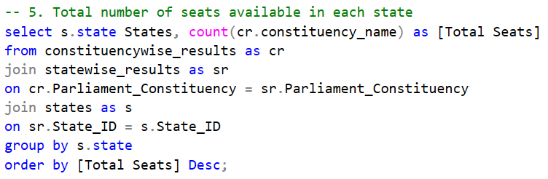
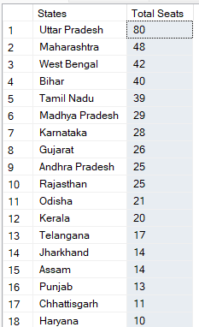
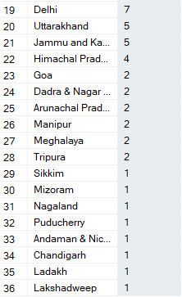
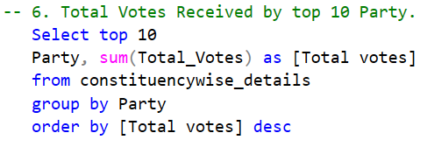
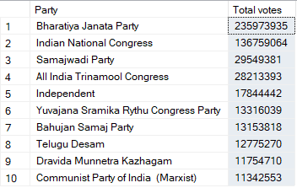
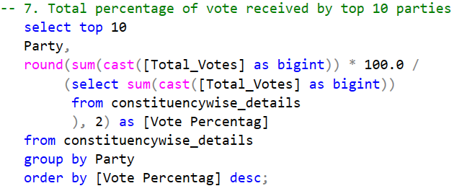
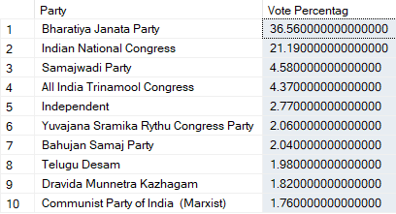
Vote Analysis
Q.5 What is the total number of seats available in each state for general elections 2024?
Result
Q.6 What is the total number of votes received by top 10 parties ?
Result
Q.7 What is the total percentage of votes received by top 10 parties ?
Result
Slide 7

Slide 9

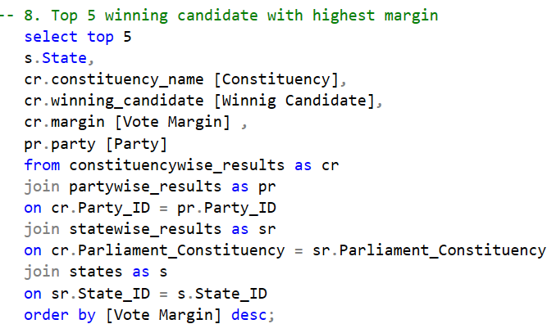
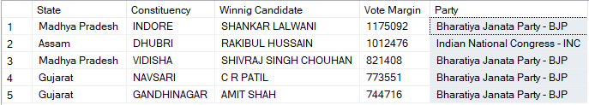
Vote Analysis
Q.8 What is the top 5 winning candidate with
highest vote margin?
Result
Slide 8

Slide 10
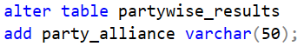
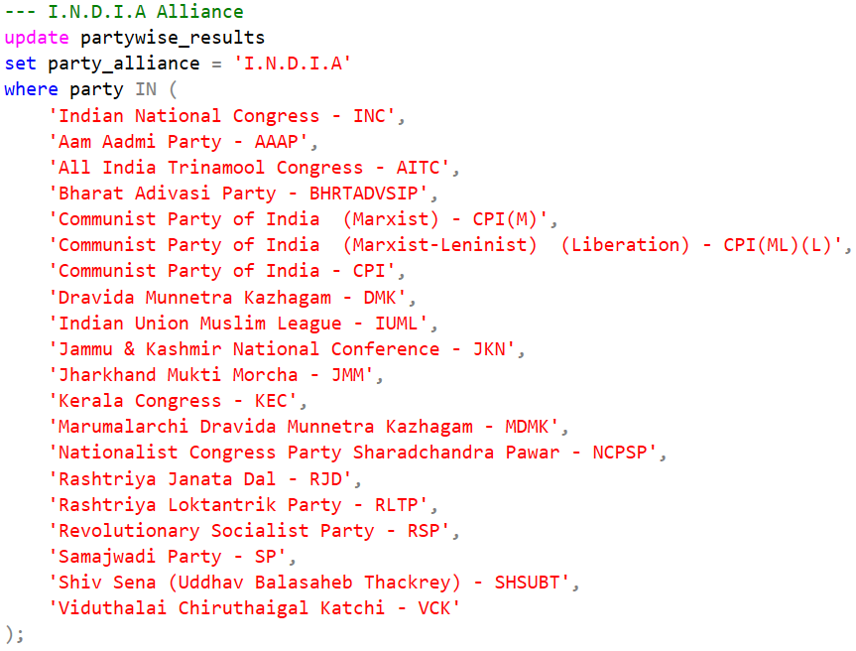
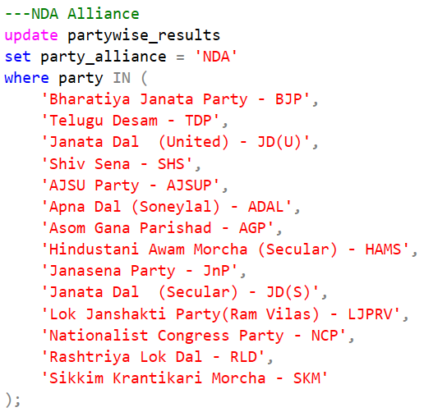
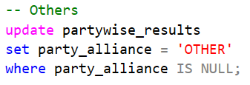

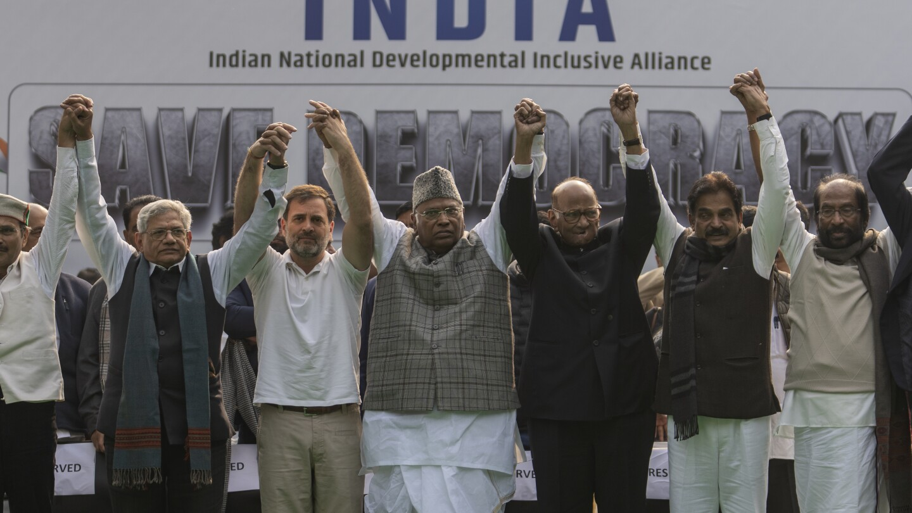
Party Alliance
Add new column field in table partywise_results to get the Party Allianz as NDA, I.N.D.I.A and OTHER
I.N.D.I.A alliance
NDA alliance
Other
Slide 9

Slide 11
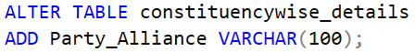
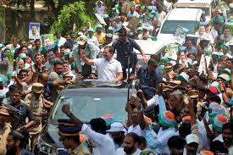
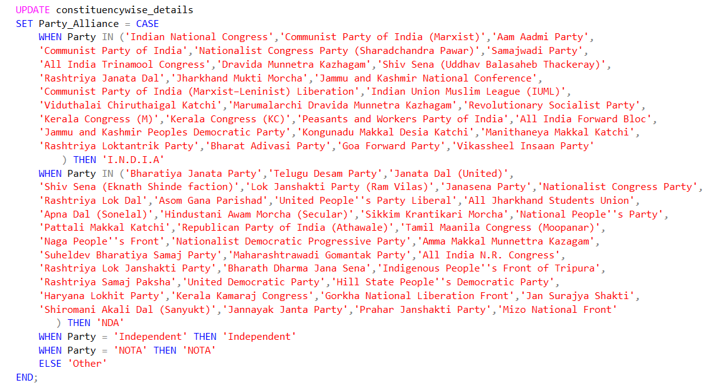
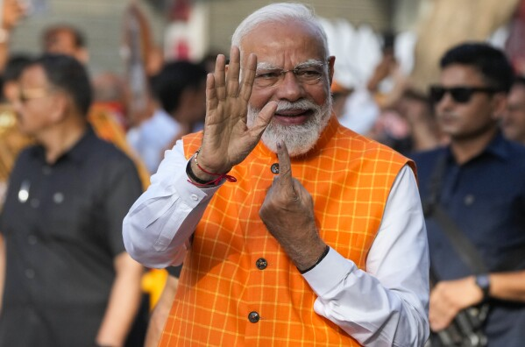
Party Alliance
Adding new column field in table constituencywise_details to get the Party Alliance as NDA, I.N.D.I.A, OTHER & Independent
Slide 10

Slide 12
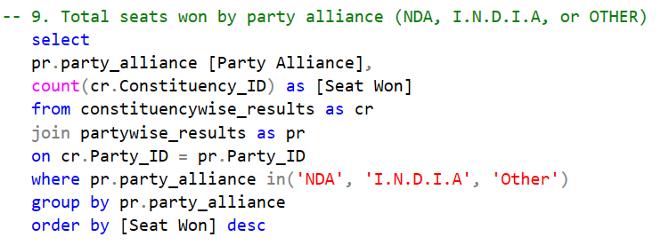
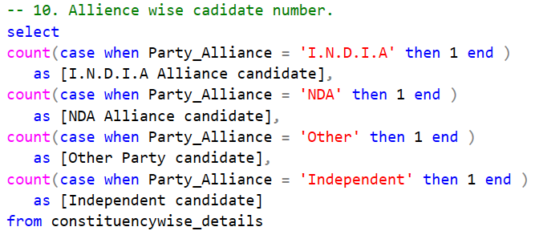

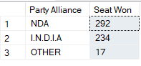
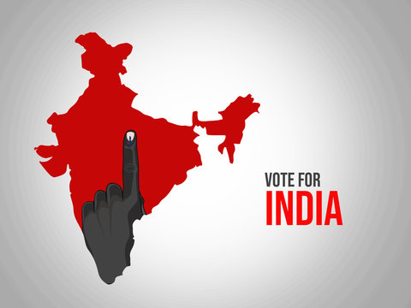
Alliance Performance
Q.9 Which party alliance (NDA, I.N.D.I.A, or OTHER) won the most seats across all states?
Q.10 What is the number of total candidates alliance wise?
Result
Result
Slide 11

Slide 13
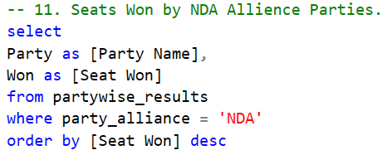
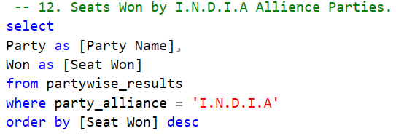

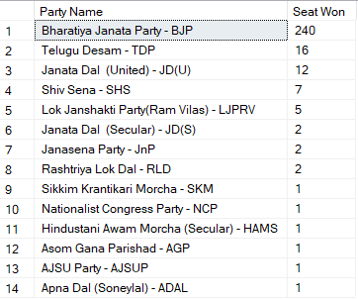
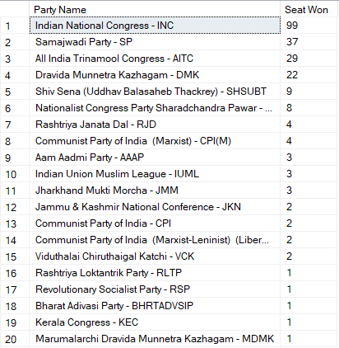
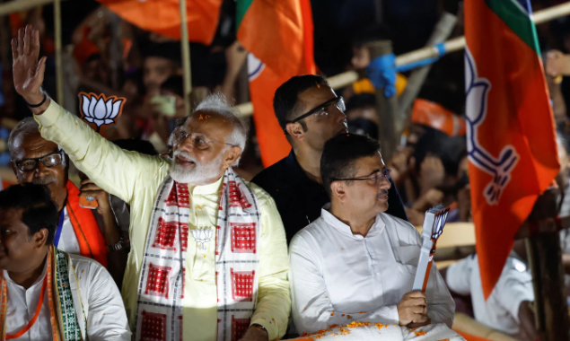
Alliance Performance
Q.11 How many seats won by I.N.D.I.A. Allianz Parties?
Q.12 How many seats won by I.N.D.I.A. Allianz Parties?
Result
Result
Slide 12

Slide 14
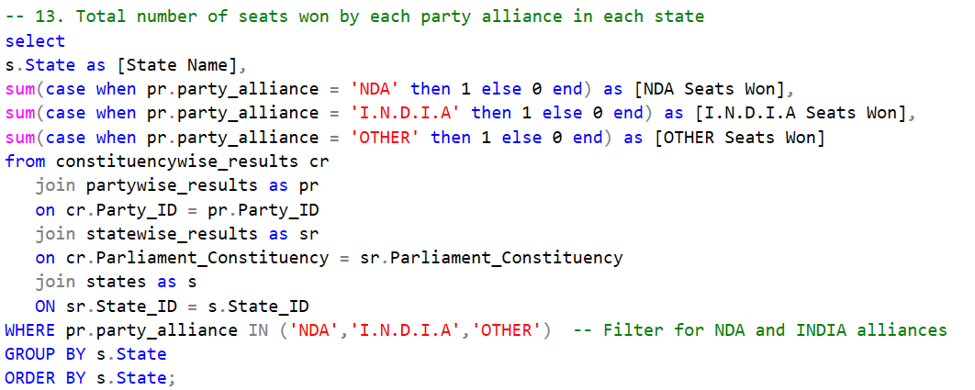
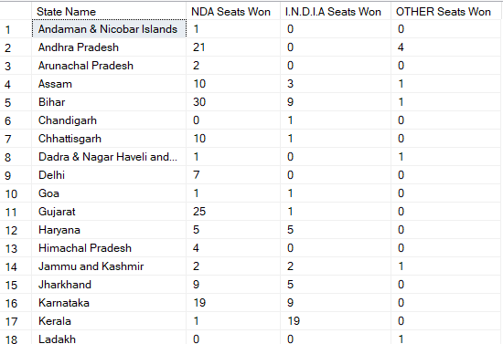
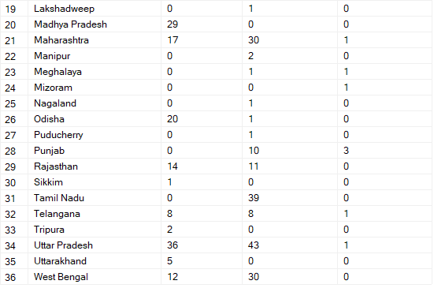
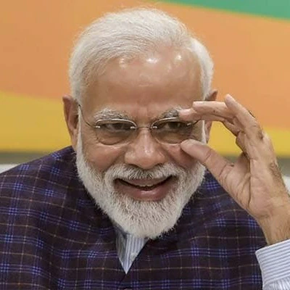
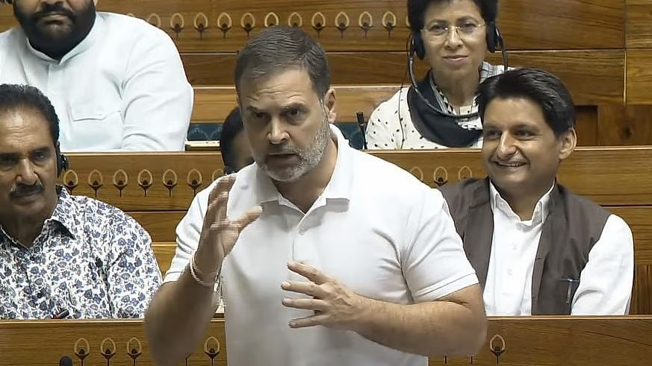
Alliance Performance
Q.13 What is the total number of seats won by each party alliance in each state?
Result
Slide 13

Slide 15
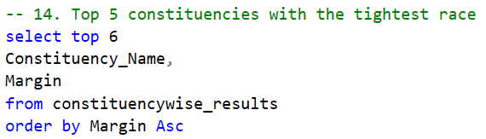
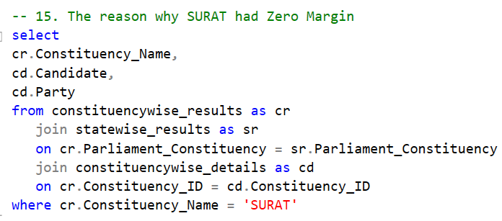
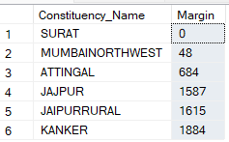
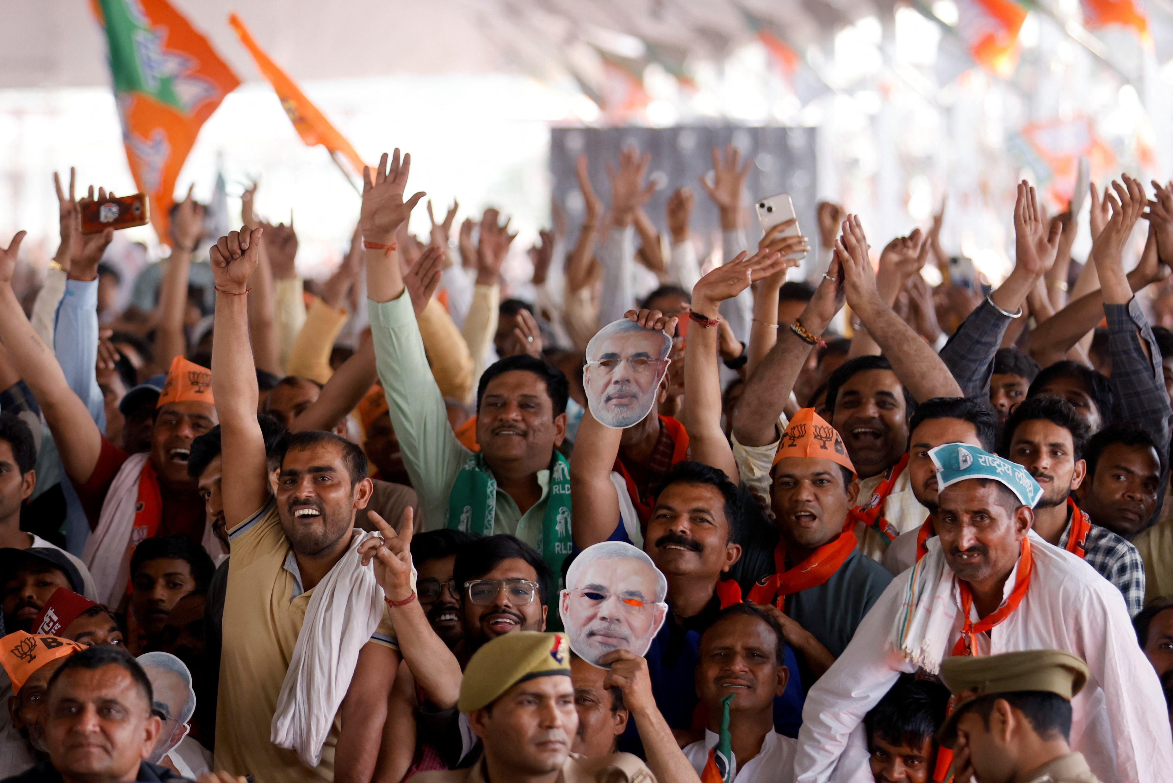
Constituency Analysis
Q.14 Which five constituencies had the closest contest?
Q.15 Why constituency SURAT had no Margin
Result
Result
Slide 14

Slide 16
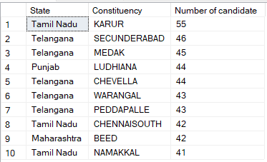
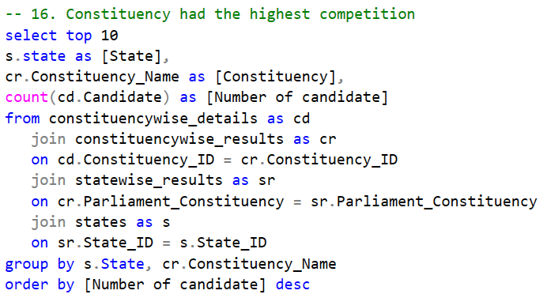
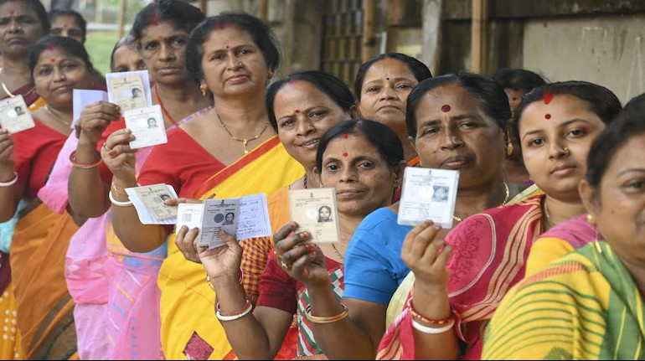
Constituency Analysis
Q.16 Which ten constituencies had the highest number of candidate?
Result
Slide 15

Slide 17
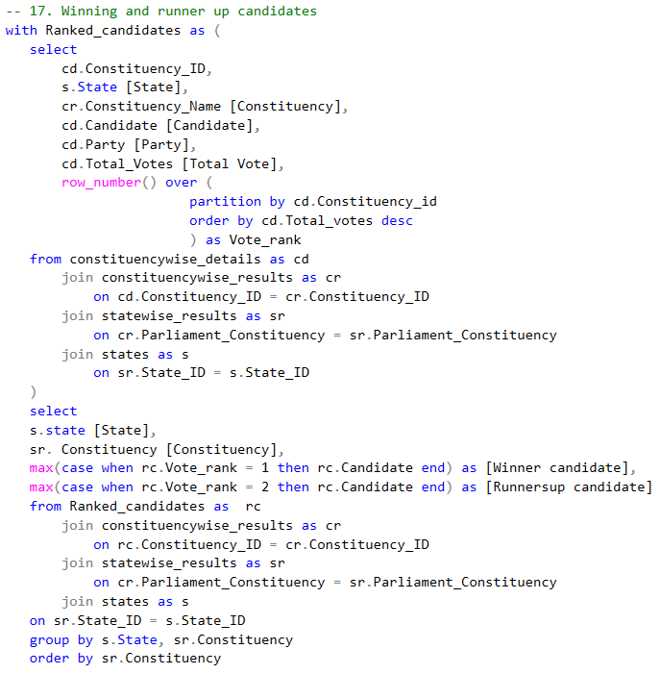

Winning Candidates & Runner-ups
Q.17 Which candidate won and which candidate was the runner-up in each constituency of State in General Election of India 2024?
Result
Slide 16
Total Output is about 543 rows

Slide 18
Conclusion & Recommendations
Conclusion
Recommendations
The 2024 elections witnessed record-high participation across constituencies and states.
The NDA alliance emerged as the dominant coalition, winning the majority of seats.
Competitive constituencies showed a narrow margin of victory, reflecting voter polarization.
Regional parties maintained strong influence in specific states, despite national trends.
Several emerging parties gained traction, indicating shifts in voter preferences.
Parties should invest more in data-driven campaign strategies in high-competition constituencies.
Election Commission should enhance transparency in postal and EVM vote handling.
Alliances should focus on regional customization of messaging and candidate profiling.
Analysts & Researchers can monitor vote share trends to forecast future election swings.
Policymakers should engage in post-election analysis to address voter concerns state-wise.
Slide 17

Slide 19
Q&A
Thank you for your attention. I now welcome any questions you may have about the 2024 General Elections data, analysis, or insights.
If you have any further questions or want access to detailed constituency-level datasets, feel free to comment.
Thank you
Slide 18

